Slide 1
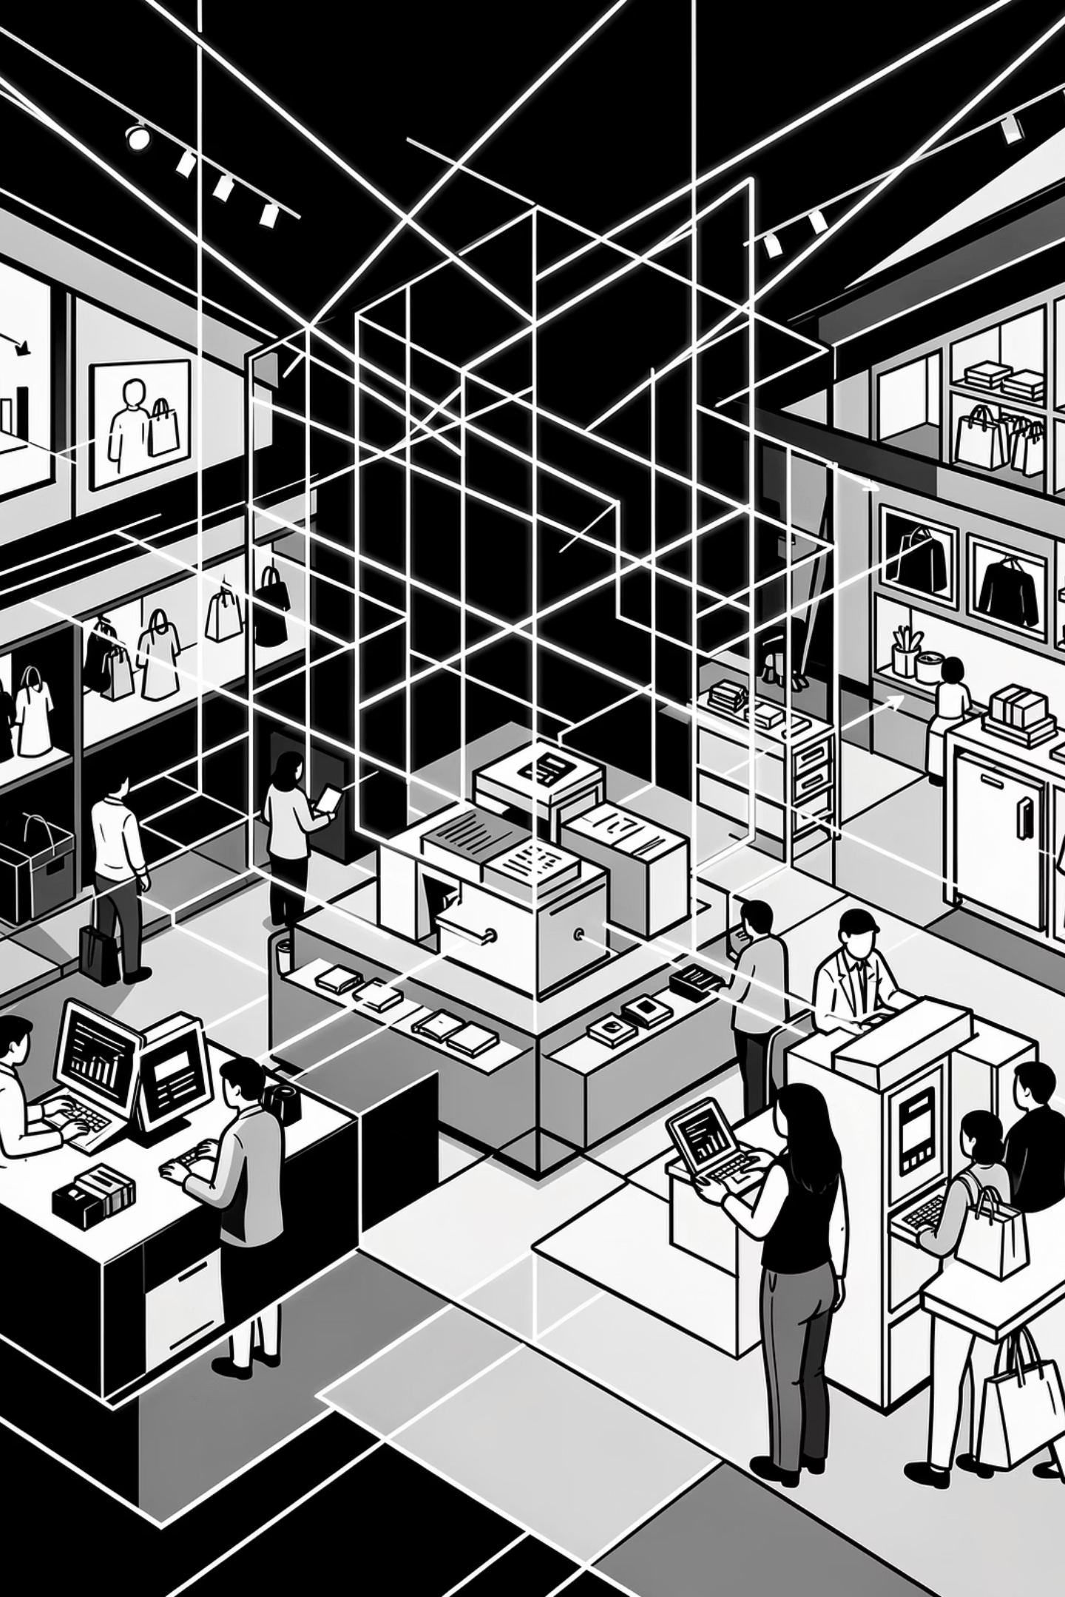
Unlocking Customer Insights
Analyzing shopping data to understand patterns and drive growth.

Slide 2

Project Goals
Boost Revenue
Retain Customers
Maximize financial performance.
Enhance loyalty and satisfaction.
Refine Products
Target Marketing
Optimize offerings and strategy.
Improve campaign effectiveness.

Slide 3
Key Objectives
1
2
Revenue by Demographics
High-Value Customers
Compare earnings across customer groups.
Identify top spenders.
3
4
Discounts & Subscriptions
Top-Rated Products
Analyze their impact.
Determine best performers.
5
6
Shipping Spend
Business Recommendations
Compare across types.
Actionable insights for growth.

Slide 4
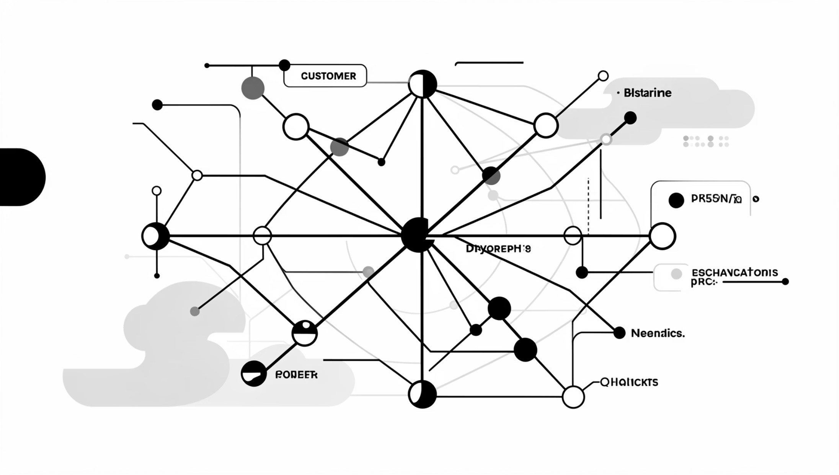
Dataset Overview
Data Points
Rows: 3,900
Columns: 18
Key Features
Customer Demographics (Age, Gender, Location, Subscription)
Purchase Details (Item, Category, Amount, Season, Size, Color)
Shopping Behavior (Discount, Promo, Previous Purchases, Frequency, Review, Shipping)
Missing Data: 37 values in Review Rating.

Slide 5
Tools & Technologies
Python
SQL
Power BI
Data Cleaning & EDA (Pandas, Matplotlib/Seaborn).
Business Queries.
Dashboard & Visualizations.

Slide 6
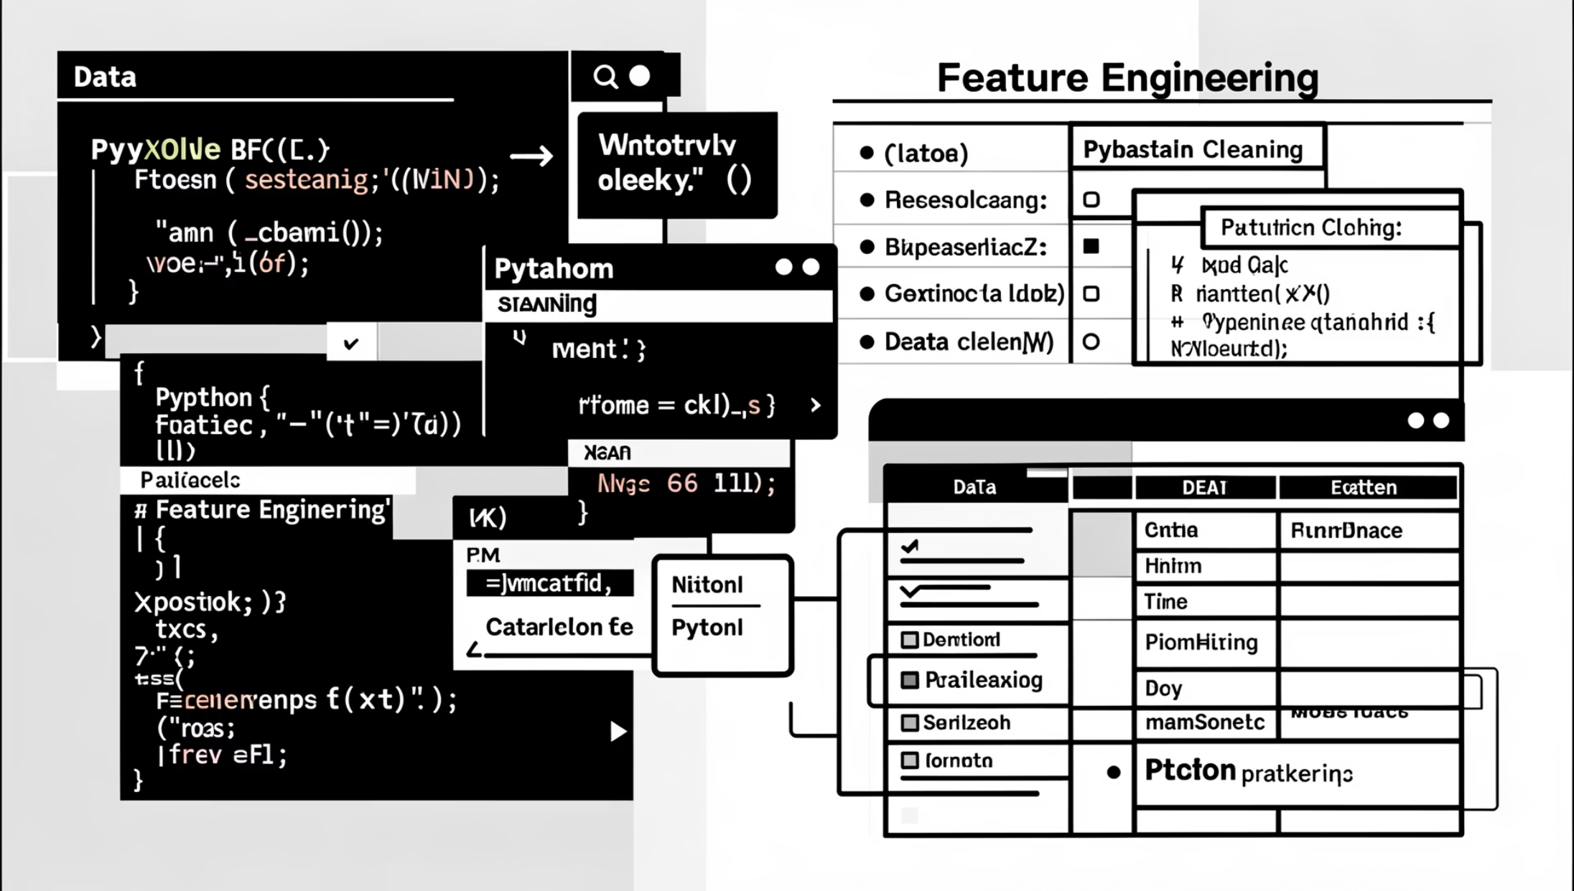
Exploratory Data Analysis (Python)
Data Preparation
Data Loading: Pandas import.
Initial Exploration: df.info() and df.describe().
Missing Values: Median rating assigned to nulls.
Standardization: Columns renamed to snake_case.
Feature Engineering: Age groups, purchase frequency.
Consistency Check: Removed redundant promo_code_used.
Cleaned data exported for SQL analysis.

Slide 7
SQL Data Analysis: Key Findings
Revenue by Gender
Discount Impact
Male vs. Female spending patterns.
839 customers used discounts, still spent above average.
Top 5 Products
Shipping Spend
Highest average review ratings identified.
Average purchase for Standard vs. Express.
Subscription Value
Discounted Products
Average spend & total revenue by subscription status.
Top 5 products with highest discount purchase percentage.

Slide 8
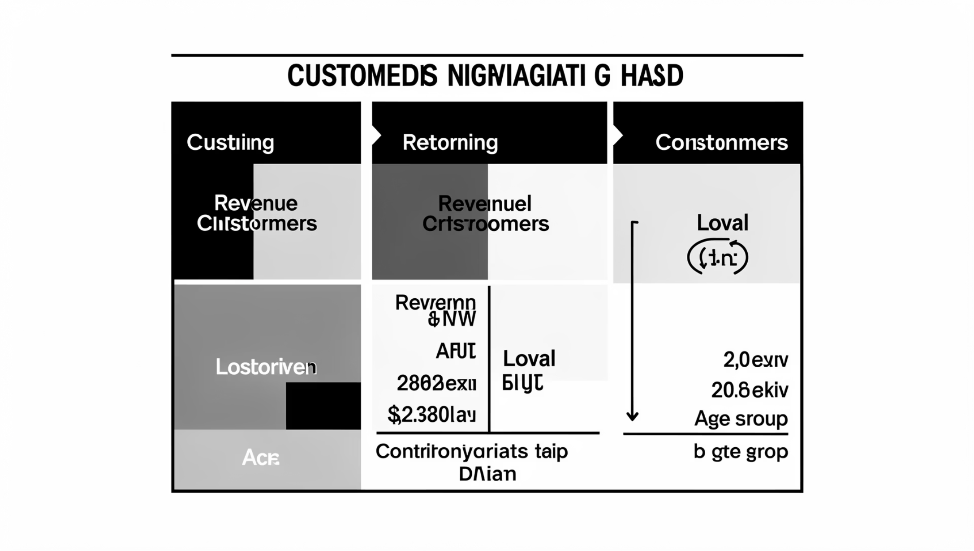
Customer Segmentation & Age Group Revenue
Customer Segments
New
Returning
Loyal
Based on purchase history.
Subscription Likelihood
Customers with >5 purchases more likely to subscribe.

Slide 9
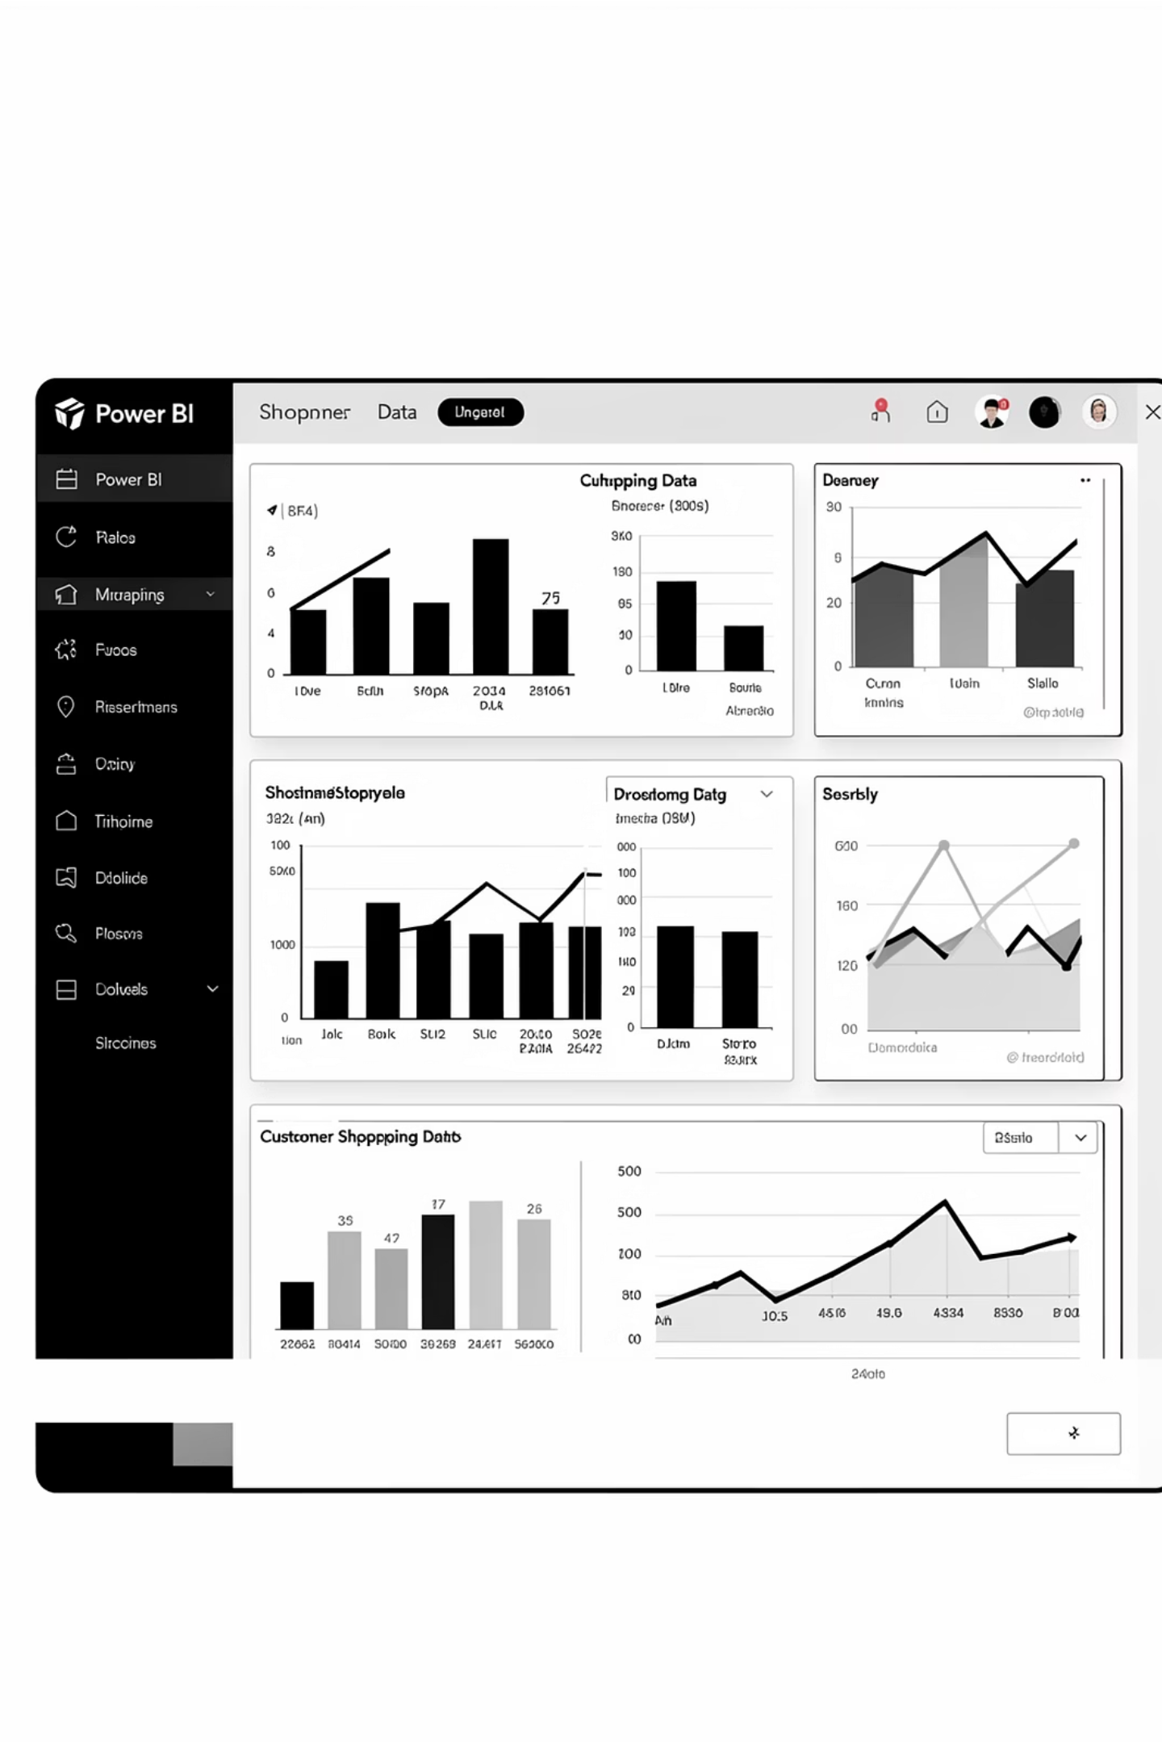
Interactive Dashboard
Visualizing key insights for easy understanding and decision-making.

Slide 10
Actionable Recommendations
Strengthen Subscriptions
Incentivize for retention.
Loyalty Initiatives
Reward repeat purchases.
Optimize Discounts
Balance sales and profit.
Enhance Product Positioning
Prioritize top-rated items.
Targeted Marketing
Focus on high-revenue groups.

